Slide 1
TURKS
Cholpon CHOTAEVA
Anthropology, AUCA

Slide 2
Contents
General characteristics of the period
Turkic Kaganate
Turgesh Kaganate
Karluk Kaganate
Qarakhanid Kaganate
Culture

Slide 3
General characteristics
Middle Ages
Turkic Era in Central Asia and Southern Siberia
First Islamic Turkic state Qarakhanids

Slide 4
Turkic Kaganate (552-744)
Name
Origin
Territory, capital
Rulers
Political system
Economy
International Relations

Slide 5
Name
Turk – name used by Sogdians, Persians, Byzantines for new nomads of the steppes
A social or political term meaning strong, stable, unconquerable used for nobility
Later an ethnic term of all nomads

Slide 6
Origin
Emerged among the Hunnu
Mongoloid race
Turkic languages

Slide 7

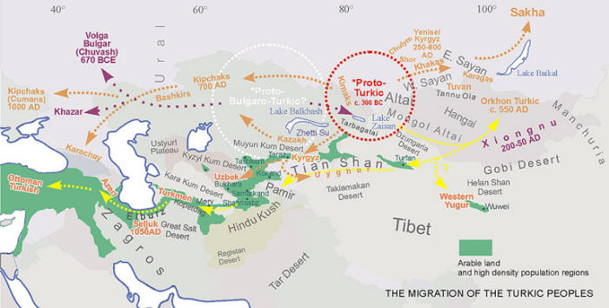

Slide 8
Territory and capital
Initial territory: Altai Mountains
Later territory: Central Asia, Southern Siberia, Northern Mongolia
603 – split into Western and Eastern
Western Turks: Central Asia (till Altai)
Eastern Turks: Southern Siberia, Mongolia (from Altai)
Capital : Orkhon (northern Mongolia)
Suyab (Western Turks)

Slide 9
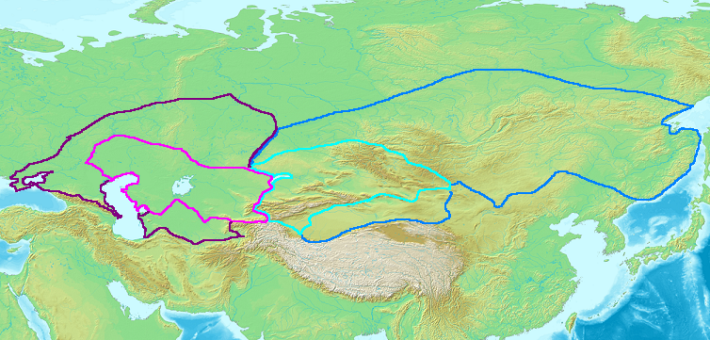

Slide 10
Rulers
Founder: Bumin
Successors:
Istemi (Western Turks in Semirechye and Tienshan)
Muqan (Eastern Turks in Southern Siberia, Mongolia)
Ton Jabgu (Western Turks)

Slide 11
Political system
Confederation of tribes (dulu, nushibi)
Kagan – ruler
Jabgu – assistant to kagan
Tarkans, buiruks, tutuks – executors of kagan orders
Beks - rulers of tribes and clans
Tribal system of the right, left wings and the center

Slide 12
Economy
Nomadic and semi-nomadic pastoralism
Agriculture in Sogdia (settled)
Hunting

Slide 13
International Relations
563, 567 - An alliance of Western Turks with Iran (Khosrau Anushirvan) against Hephthalites in Central Asia
An alliance of Western Turks with Byzantine against Persians
571 - War of Western Turks with Iran
630 – Chinese defeated Eastern Turks
656 – Chinese defeated Western Turks

Slide 14
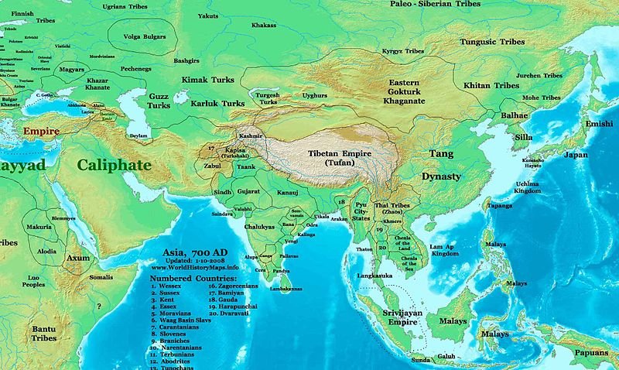

Slide 15
Turgesh Kaganate (704-766)
Territory: Semirechye, Tienshan
Rurlers: Uch Elig (from the Yellow Turgesh), Sakal
Capital: Suyab

Slide 16
International Relations
Chinese (Tan dynasty) threatened from the south
Eastern Turks threatened from the east
Arabs threatened from the south-west
710 – an alliance of Turgesh, China and Yenisei Kyrgyz was formed against Turks

Slide 17
Karluk Kaganate (VIII-X)
Karluk Bodun – three tribes of Karluk: Bulak, Chigil and Tashlyk
Territory: from Mongolia till the Balkhash Lake, later Semirechye
Capital: Suyab
Ruler with the title Jabgu

Slide 18
International Relations
744 – A coalition of Karluks, Uighurs and Basmyls defeated Eastern Turks
746 – the new rulers of the Steppe, Uighurs, forced Karluks to Semirechye
751 – Talas battle, where Karluks fought with Arabs against Chinese

Slide 19
Qarakhanid Kaganate (X-XII)
Qarakhanids –from ”Great Khan” introduced by Russians in XIX century
Origin: from Karluks
Territory: Semirechye, Tienshan, Fergana, Eastern Turkestan
Capital: Balasagun city (Uzgen, Kashagar)
Founder: Satuk Bughra Khan
Religion: Islam

Slide 20
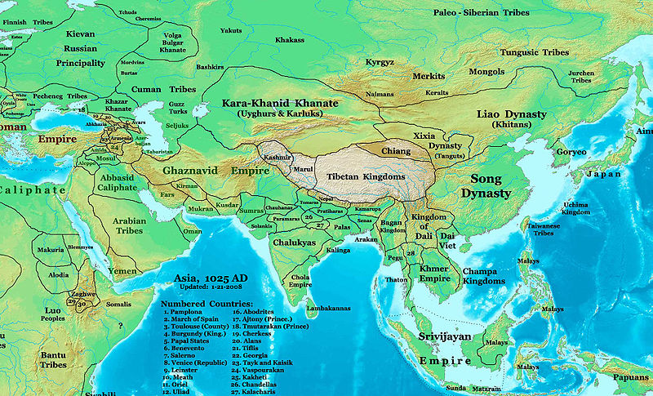

Slide 21
Economy
Agriculture
Land ownership:
Divani – state lands
Iqta – private lands
Taxes:
Kharaj, zakat – land taxes
Khashar – labor rent
Other taxes (natural, money)

Slide 22
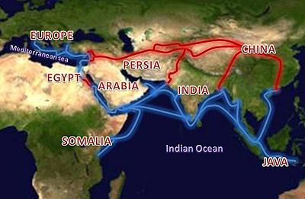
Economy
Trade
Great Silk Road - international overland trade route across the Asian continent (network of routes)

Slide 23
International Relations
Wars with Samanids (capital – Bukhara)
Seljuks defeated Qarakhanids but did not interfere in internal affairs
Qarakhitay (Mongolian nomads) defeated Qarakhanids and established their dynasty

Slide 24
Culture (VI-XII)
Art
Housing
Clothing
Religions
Literature
Science
Architecture

Slide 25
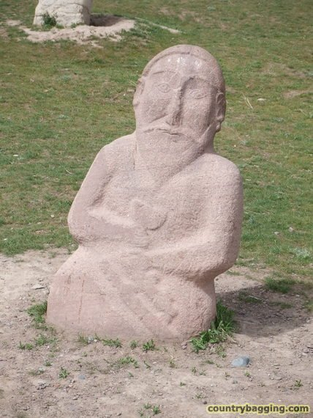
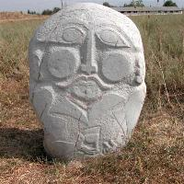
Art
Balbals – stone sculptures (VI-X)
found in Northern Kyrgyzstan
Round sculptures with clear proportions and details (clothes, jewelry, weapons)
Flat sculptures with face and facial features
Male of Mongoloid origin,
a vessel in the right hand
and a knife or sabre on the waist

Slide 26
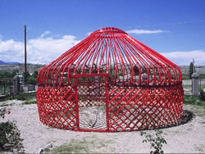
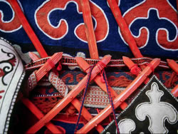
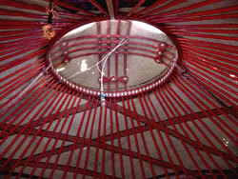
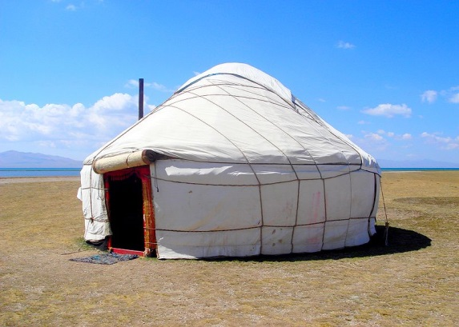
Housing
Yurt – portable house
Functionally:
Right side (epсhi jak) - female section
Left side (er jak) - male section
The most honorable place (tyor) –
opposite to the entrance

Slide 27
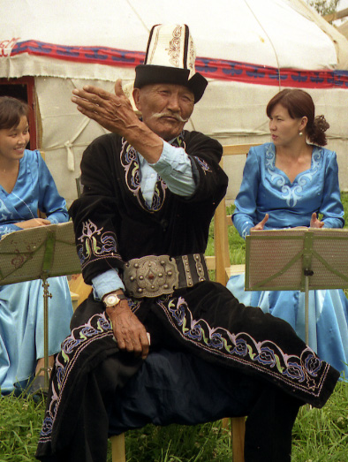
Clothing
Long shirt– koynok
Trousers – dambal, shym
Cloak - chepken
Furcoat – ichik
Males outerwear – ton
Males headdress - kalpaks,
tebetei
Females headdress – elechek (turban), topu
Skirt - beldemchi

Slide 28
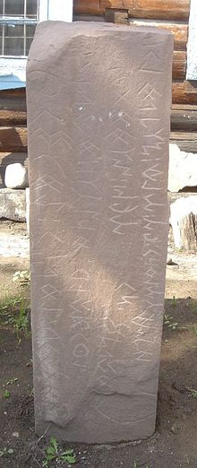
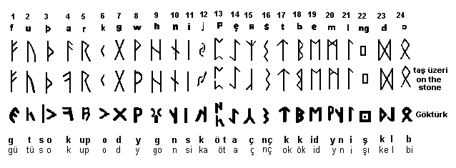
Written language
VII – Runic (Orkhon) script

Slide 29
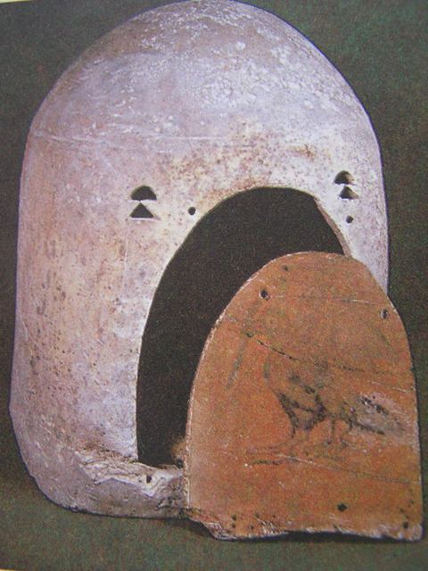
Religions
Shamanism
Zoroastrianism
Buddhism
Christianity
Islam

Slide 30
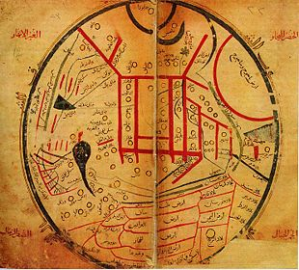
Literature
Divan Lugat at-Turk (Dictionary of Turkic Languages) of Makhmud Kashgari
Kutadgu Bilig (Blessed Knowledge) of Yusuf Balasaghuni
Firdawsi (Shahname)

Slide 31
Science
Medicine: Ibn Sina
Philosophy: Farabi
Astronomy: Biruni

Slide 32
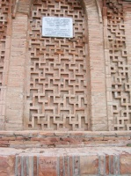
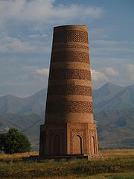
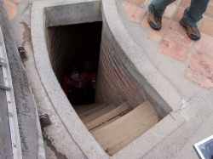
Architecture
Burana Tower (XI century)
Minaret
Balasagun (near Tokmok city)
Height – 24 m (40 m)
Made of mud bricks

Slide 33
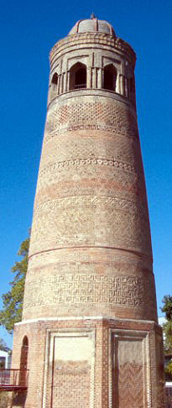
Architecture
Uzgen Minaret (XI century)
Three parts:
the lower part is an octahedron
the middle part is a tapering cylinder
the upper part is a lantern with a cupola and arched windows
Height - 27.5 m (44.7m)
Made of mud bricks
11 ornamented belts

Slide 34
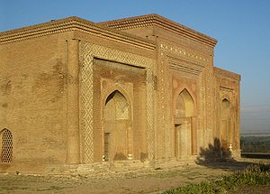
Architecture
Uzgen Mausoleums (XI-XII centuries)
Three mausoleums:
Northern
Middle (height 13 m)
Southern
Made of mud bricks
Decorated with a geometrical and vegetation pattern, terracotta tiles and carved Arabic inscriptions

Slide 35
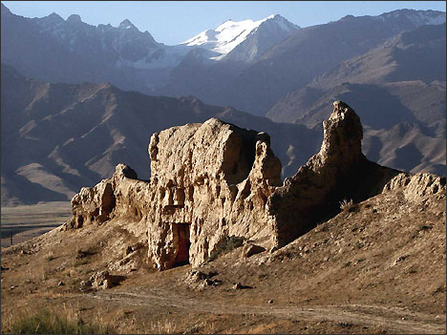
Architecture
Koshoi Korgon (VII-XIII centuries)
Fortified settlement
Naryn region
Headquarters of
nomadic rulers
(At Bash)
Walls height – 5-8 m
(10 m)

Slide 36
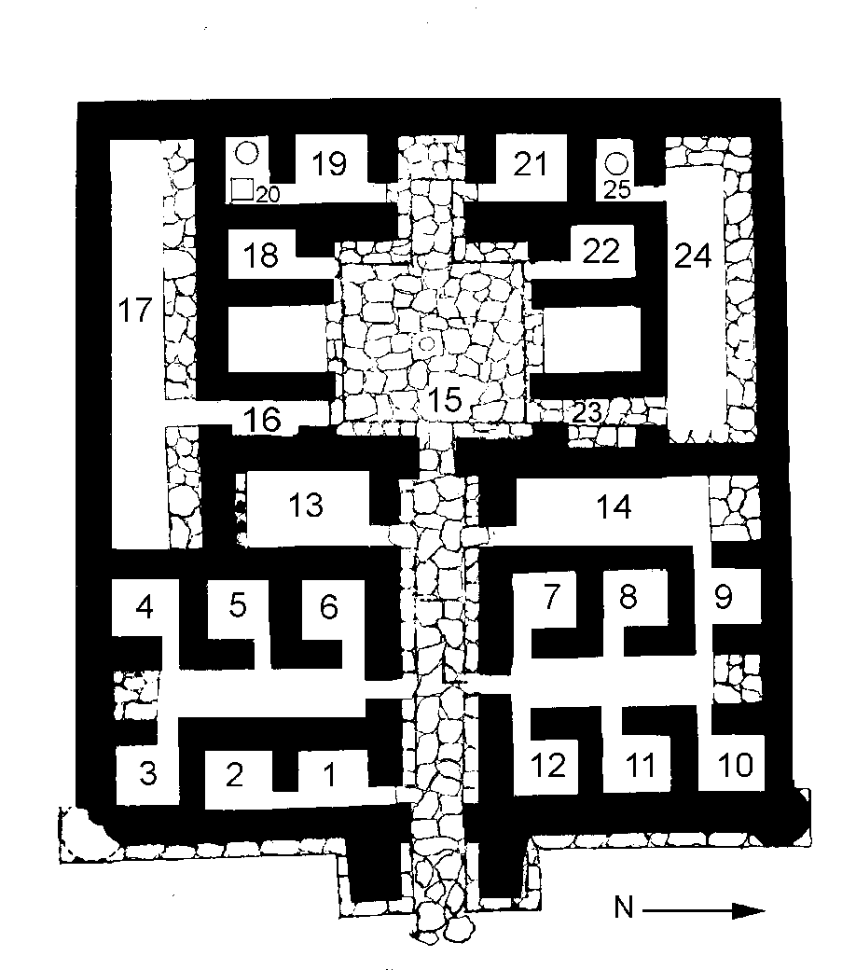
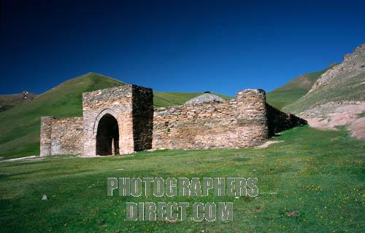
Architecture
Tash Rabat Caravansary (XV century)
Naryn province
A medieval inn for
merchants and travelers

Slide 37
Conclusion
Golden Age in Eurasia
Science brought to Europe
Bridge between the East and the West

Slide 38
Reading
Balasaguni, Yusuf. Beneficent Knowledge, trans. Walter May (Bishkek, 1998), pp 302-311.

Slide 39
Map Quiz!
To prepare for a map quiz work with the interactive maps at: http://depts.washington.edu/silkroad/maps/mapquiz/mapquiz.html
“Water and Mountains-East” and “Cities of the Silk Road”.

